Slide 1
Question 1:
Do campaign contributions predict electoral success?

Slide 2
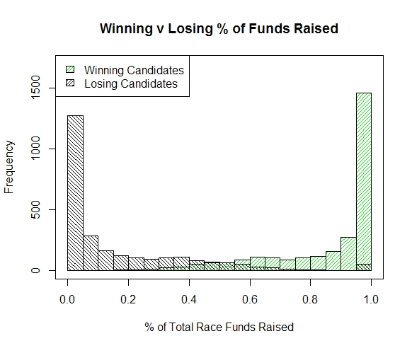
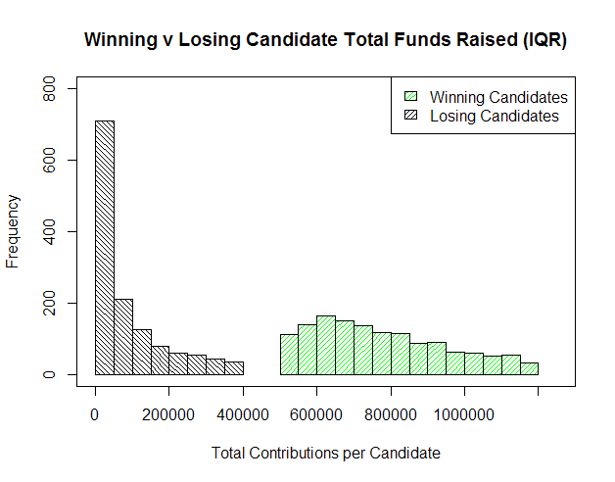
Winning candidates raise more money than losing candidates

Slide 3

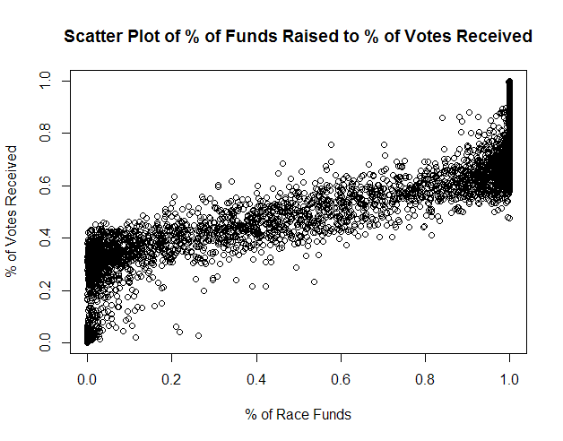
Funding is highly correlated with electoral success:

Slide 4
Association rules show the same pattern, with a caveat…
Rule | Support | Confidence | Description
{CANDTOTALLEVEL=Very Low} => {WINNER=0} | 0.301615 | 0.724322104 | 72.4% of candidates who raised very low amounts lost
{WINNER=0} => {CANDTOTALLEVEL=Very Low} | 0.301615 | 0.748556386 | 74.9% of losing candidates raised very low amounts of money
{CANDTOTALLEVEL=High} => {WINNER=1} | 0.055601177 | 0.779002876 | 77.9% of candidates who raised a high amount won
{INCUMBENT=1} => {WINNER=1} | 0.509512078 | 0.953451146 | 95.3% of incumbents won reelection
{WINNER=1} => {INCUMBENT=1} | 0.509512078 | 0.853352436 | 85.3% of winners were incumbents
{CANDTOTALLEVEL=Very Low} => {INCUMBENT=0} | 0.314309177 | 0.754806902 | 75.5% of candidates who raised a very low amount were challengers
{INCUMBENT=0} => {CANDTOTALLEVEL=Very Low} | 0.314309177 | 0.675044092 | 67.5% of challengers raised a very low amount of funding
{CANDTOTALLEVEL=High} => {INCUMBENT=1} | 0.05460891 | 0.765100671 | 76.5% of candidates who raised a high amount of funding were incumbents
{CANDTOTALLEVEL=Mid-High} => {INCUMBENT=1} | 0.111510299 | 0.70116179 | 70.1% of candidates who raised a mid-high amount were incumbents
Difficult to separate out effects of Incumbent variable from Winner variable

Slide 5
Do campaign contributions lead to electoral success

Slide 6
Models
Decision Tree
Naive Bayes
Lazy Model: K-nearest Neighbor (KNN)

Slide 7
Evaluation Metrics
accuracy: (# of right predictions) / (all predictions)
precision: true positives
recall
F-measure: consider both precision and recall

Slide 8
Question 2:
Do campaign contributions predict an industry’s performance?

Slide 9
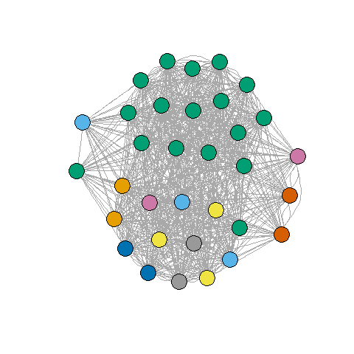
We couldn’t really answer this question…
Data weren’t binned in a manner conducive to answering it
No stock data for some major contributors (nonprofits, not publicly traded, other)
Green cluster: candidates primarily supported by nonprofits and the financial industry.

